Slide 1


Slide 2
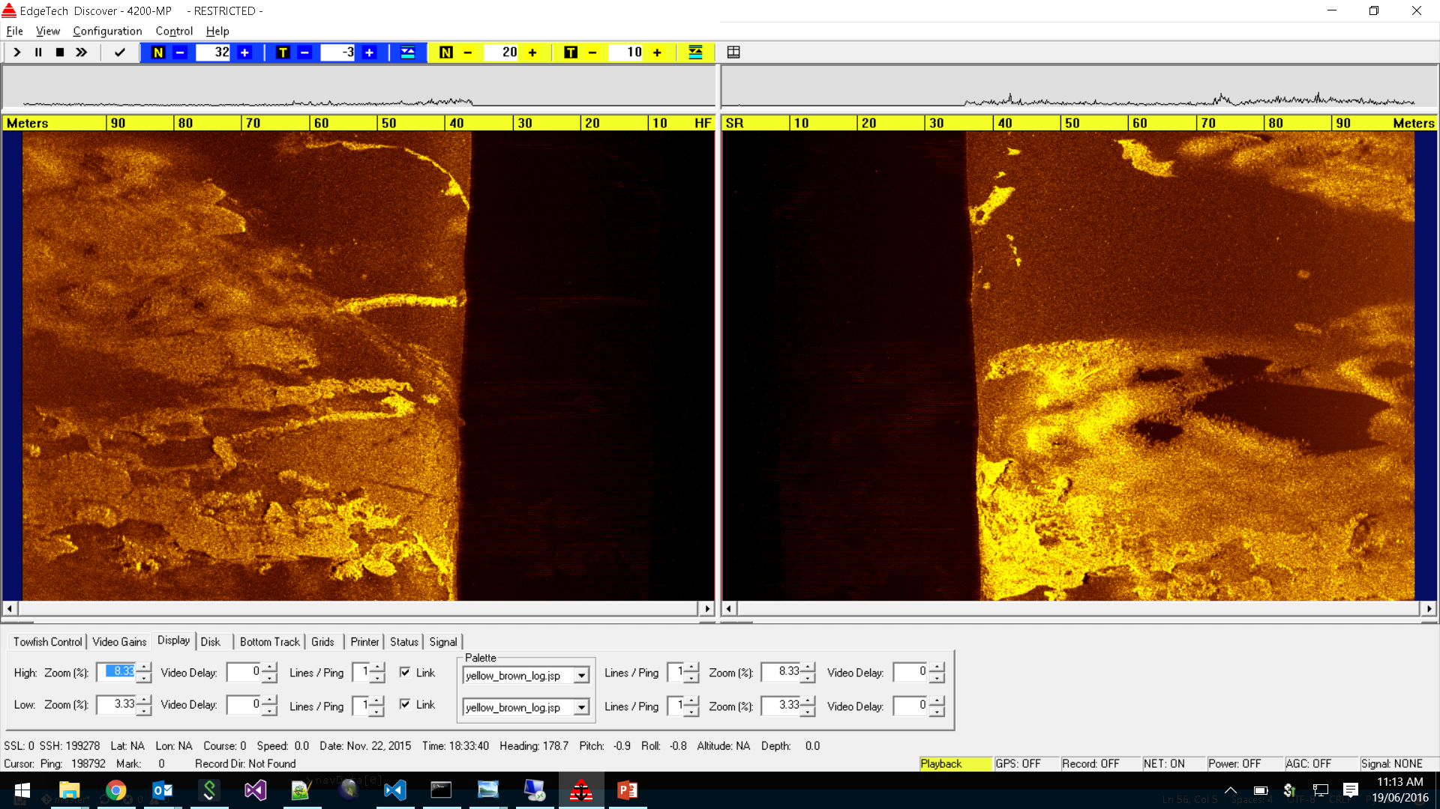
Yellow-Brown Logarithmic scale

Slide 3
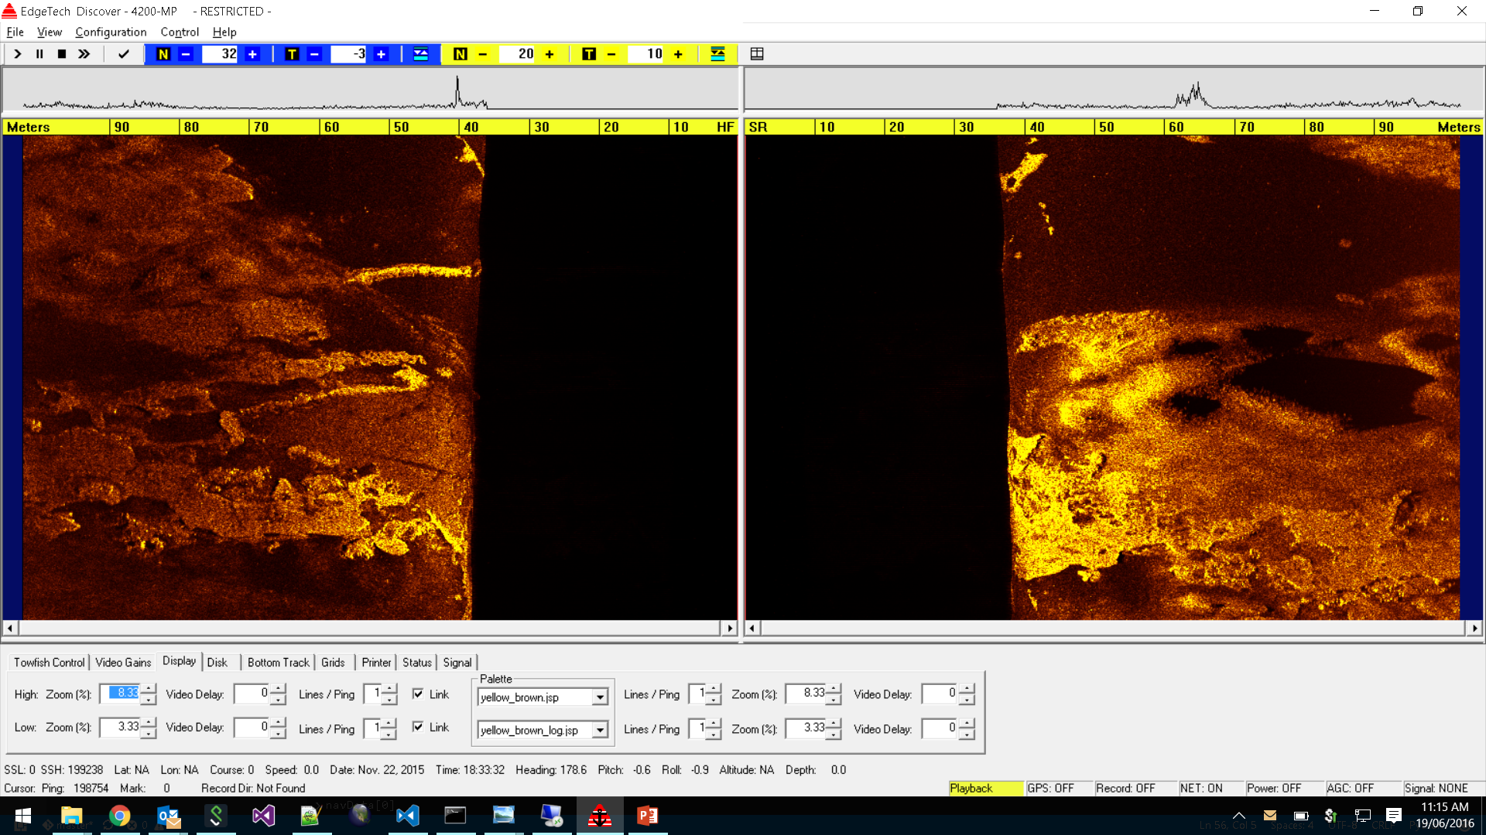
Yellow-Brown scale

Slide 4
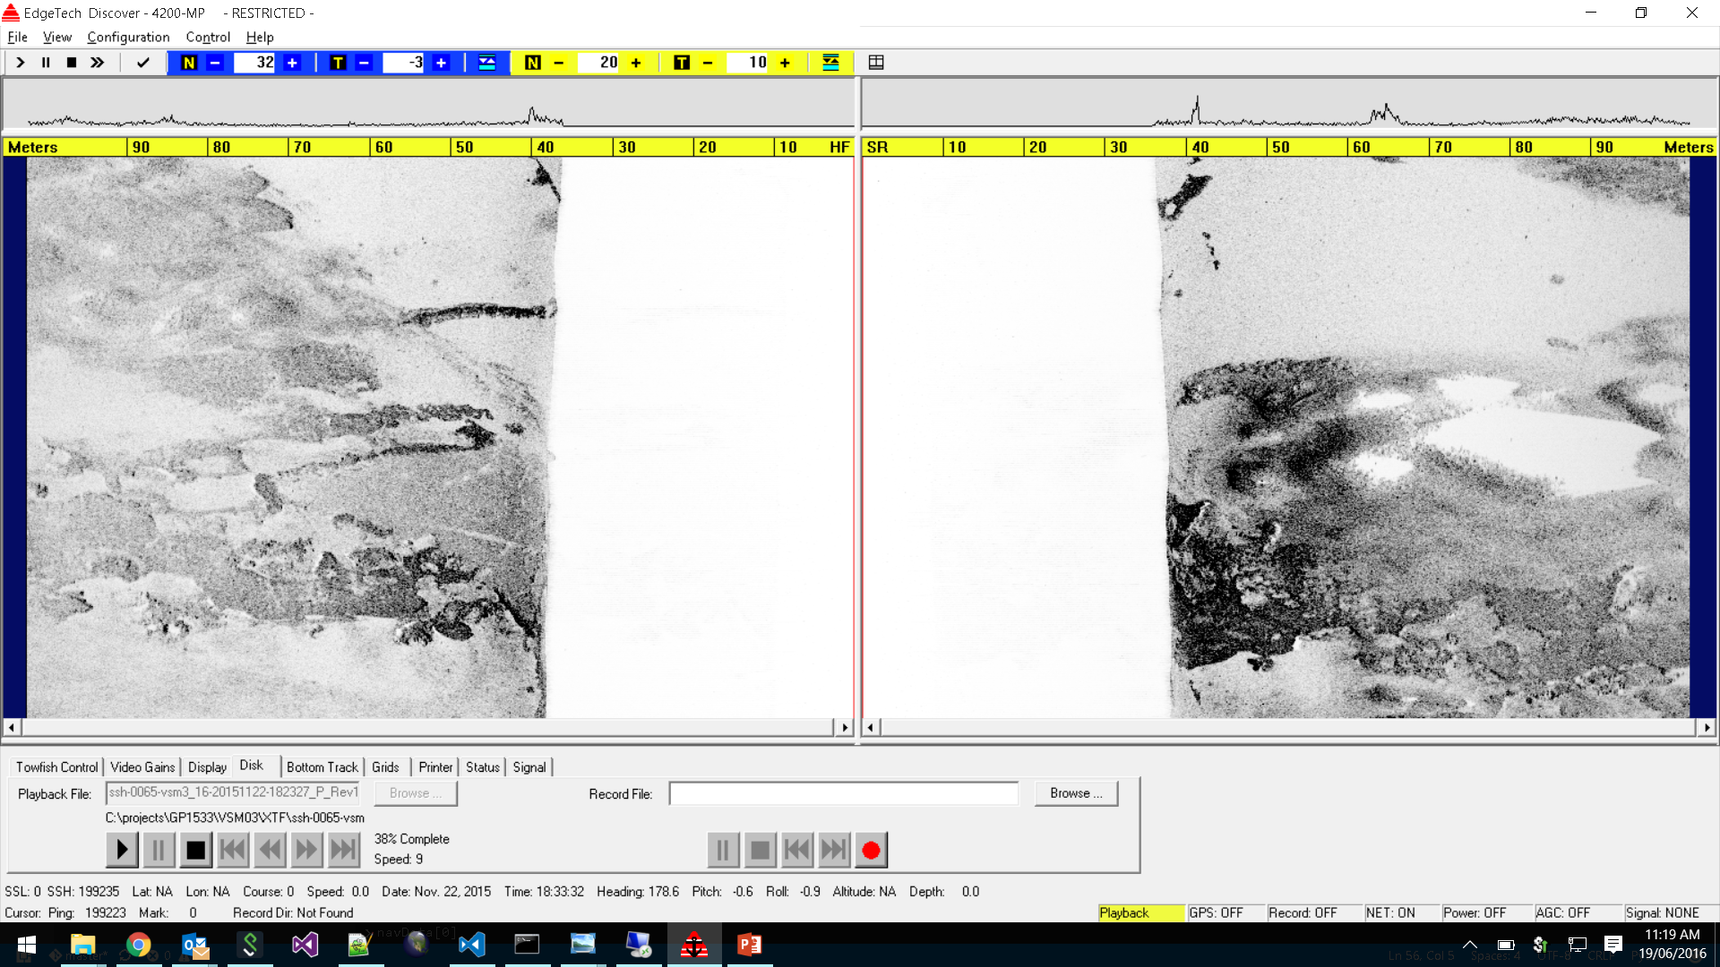
Discover Greyscale

Slide 5
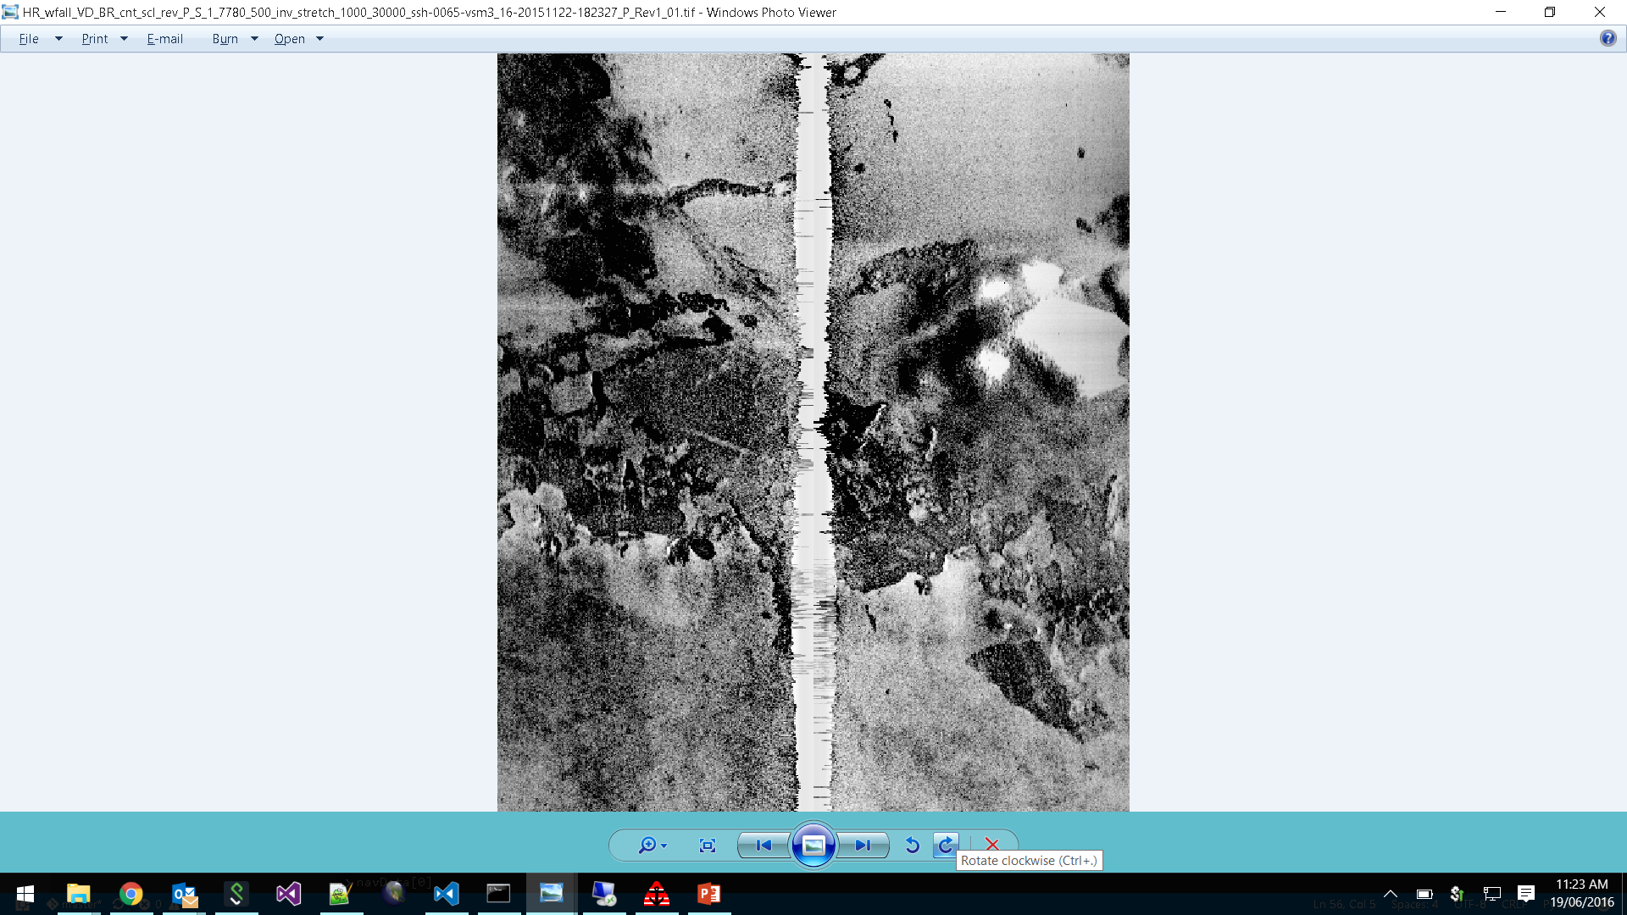
CSIRO Greyscale

Slide 6
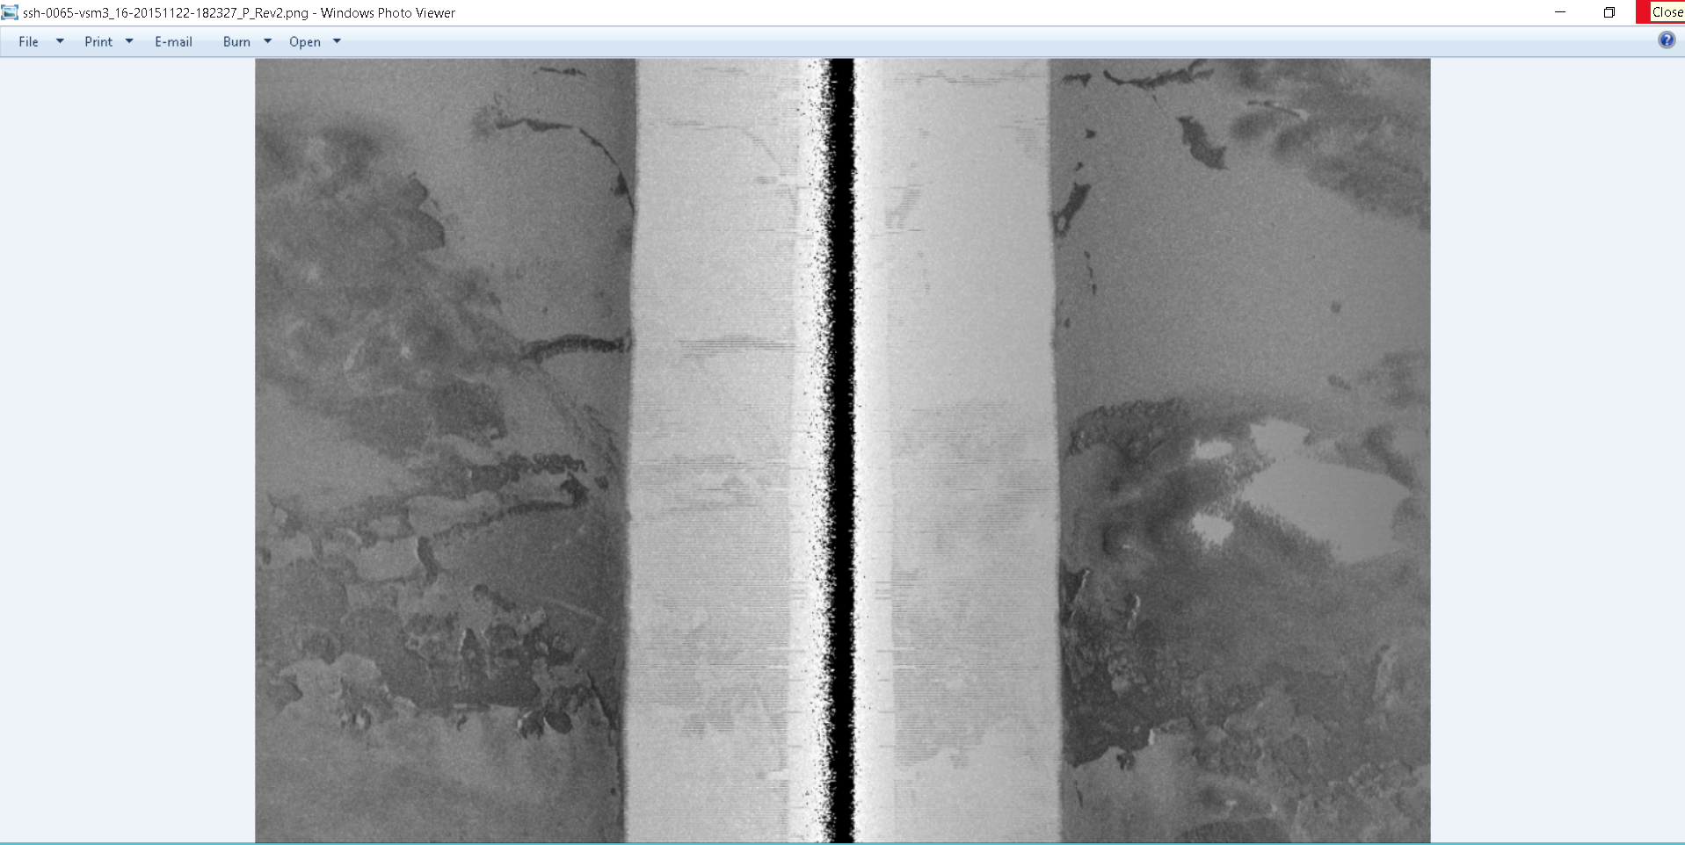
SonarBeamCorrection Gryscale Logarithmic

Slide 7
scale

Slide 8
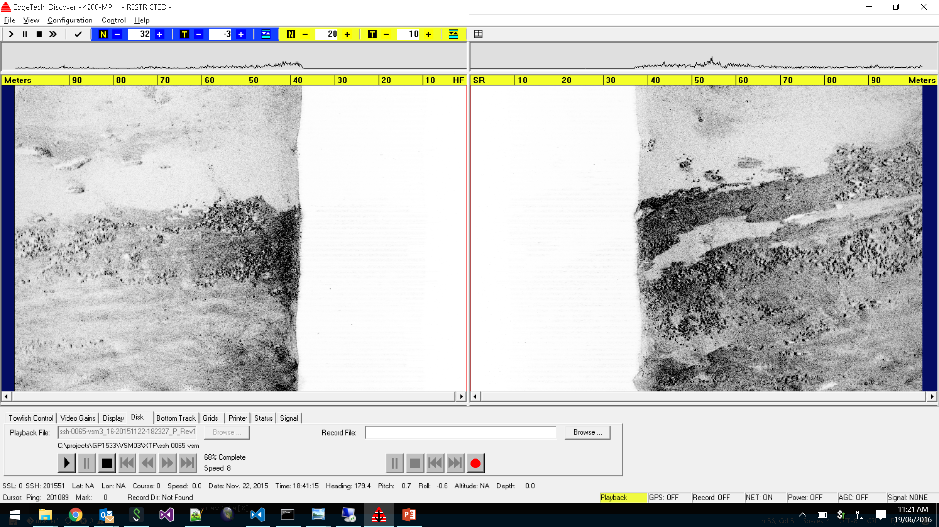
Discover Greyscale

Slide 9
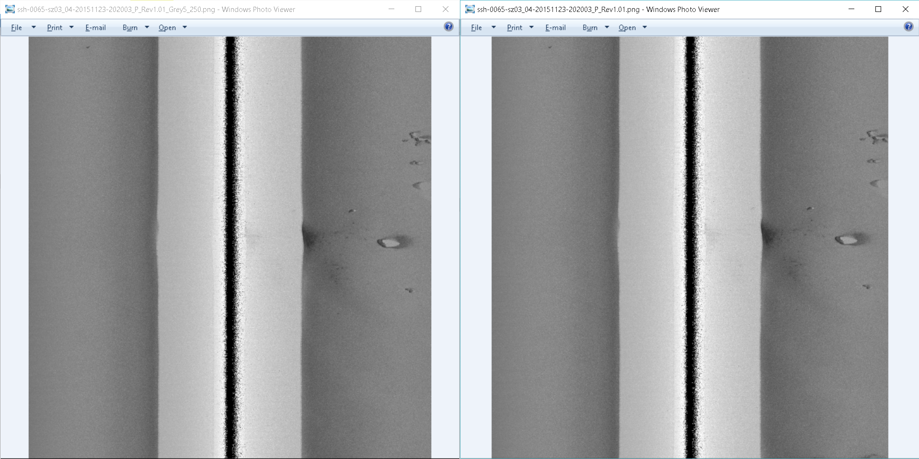
5/250 vs 0/255 grey scale

Slide 10
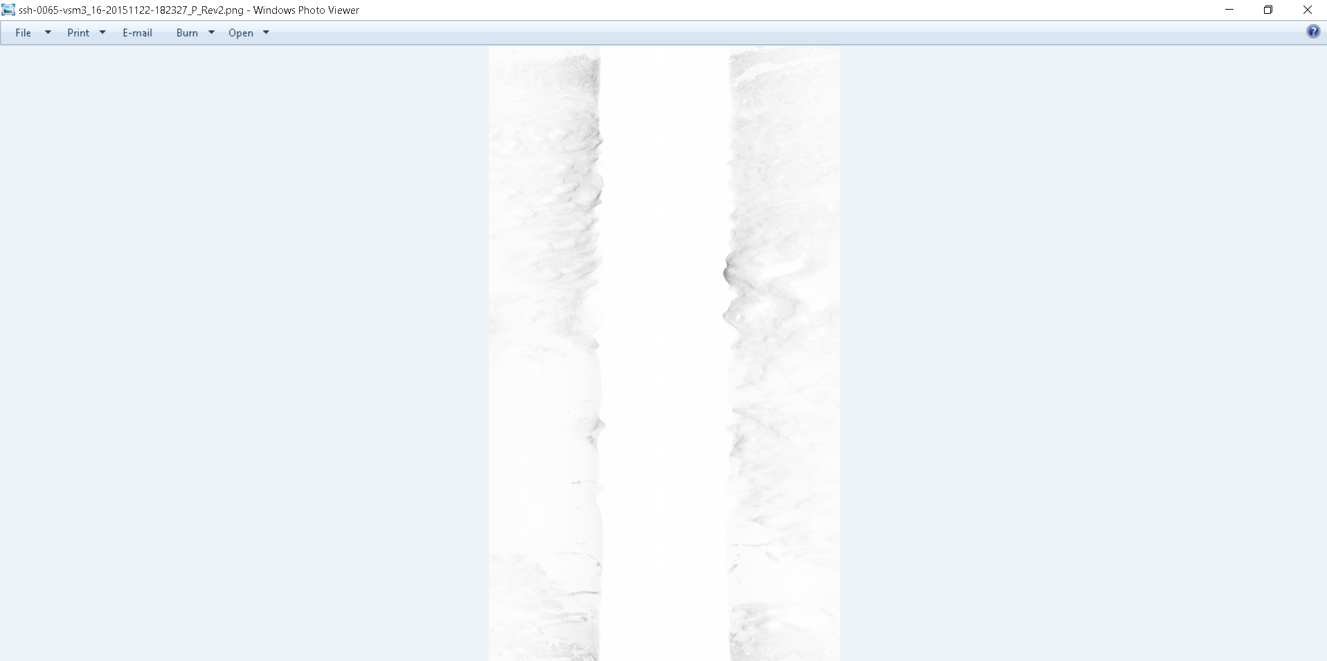
scale

Slide 11
scale

Slide 12
scale

Slide 13
scale

Slide 14
scale

Slide 15
scale

Slide 16
scale

Slide 17
scale

Slide 18
scale

Slide 19
scale

Slide 20
scale

Slide 21
scale

